Slide 1

Stage 3 Max’s Arizona Field Day Course Designer: Max Leograndis & Marcel Englmaier
Carbine: 12 paper Handgun: 12 paper, 4 steel
The start position is standing anywhere inside shooting areas. Handgun loaded and holstered. Carbine either loaded, stock touching belt, safety on OR staged loaded, safety on on the table(wrists below belt in this case).
On the audible start signal, engage all targets from within the shooting areas. Steel must be engaged with Handgun Calibers for 1 hit eat from the box AND 1 hit each from the big shooting area.

Slide 2
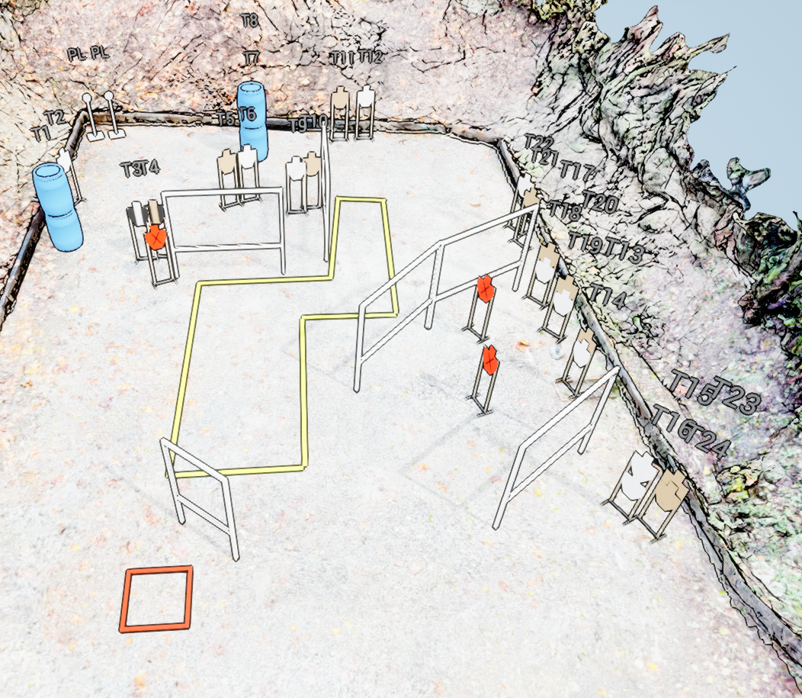
 | Stage 3 Max’s Arizona Field Day Course Designer: Max Leograndis & Marcel Englmaier
Dump table
Dump table

